Slide 1
E-Commerce Analysis
Presented BY
Monisha J

Slide 2
Agenda:
Introduction to E-Commerce Analytics
Analyzing Popular Brands, Category & Insights
Analyzing Price Trends and Discount Strategies
Understanding Seller behavior and Performance
Investigating customer preferences and product satisfaction
Exploring correlations between various attributes such as price, rating, and brand

Slide 3
Problem statement
The dataset comprises information on products available on the e-commerce platform.
It includes attributes such as product details, pricing, seller information, and more
To outline the objectives, methodologies, and expected outcomes of an e-commerce product analysis project.
This analysis aims to provide insights into various aspects of product data collected from a major Indian e-commerce platform.

Slide 4
Tools Used and Methodology
Imported given dataset in PowerBI and performed Data cleaning and validation using Power Query, DAX functions.
Performed Descriptive Analysis for given data set using PowerBI to understand dataset like unique values, record count, min, max, avg values in each columns.
Data Cleaning & Transformation:
Replaced Null values with “Unknown” in “Seller”, “Brand” columns
Removed “URL”, “Images” from given dataset.
Transformed “discound” column spilite by % (String to Numeric)
Ensure all data types are correctly set like “crawled_at”, “brand”, “selling_price” etc.,
Created required measures, columns, table data for Visualizations

Slide 5
Metrics Creations using Power Query, DAX functions
Created required measures, columns, table data for Visualizations
Identifying popular product categories and Brand :
Popular Product Categories, Brand
Total Revenue per brand, Category
Average rating by brand, Category
Discounts Offered by different Brands and Categories
Analyzing pricing trends and discount strategies :
Average Ratings vs. Selling Price
Price pattern over time
Discounts Offered by different Sellers and Products
Understanding seller behavior and performance :
Number of products sold by each seller for Performance
Total revenue by Sellers
Average rating against Sellers
Discounts Offered by Sellers

Slide 6
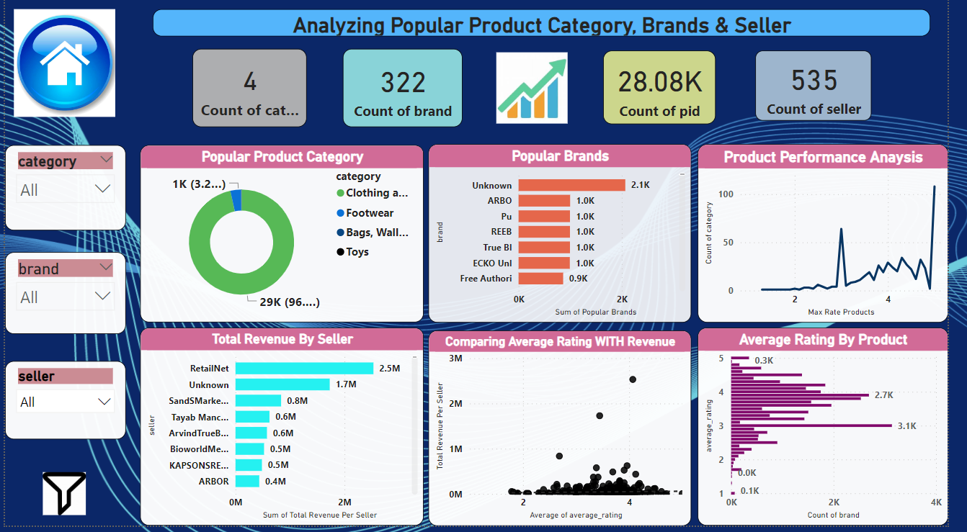
Analyzing Popular Product Category ,Brands & Seller

Slide 7
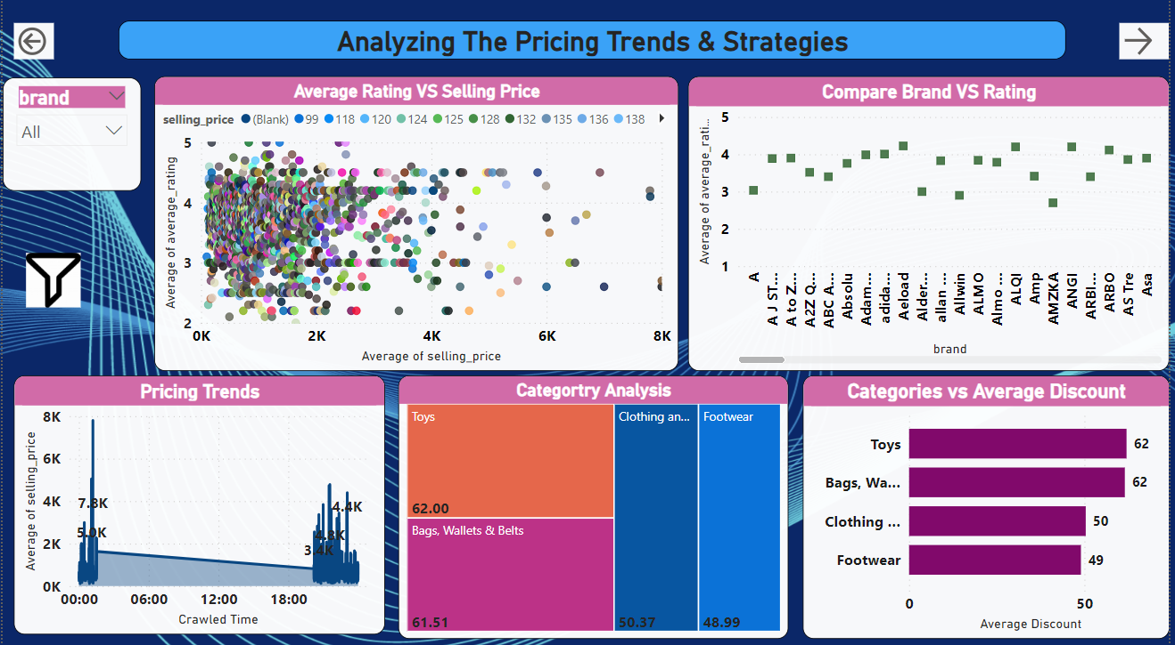
Analyzing The Price Trends & Strategies

Slide 8
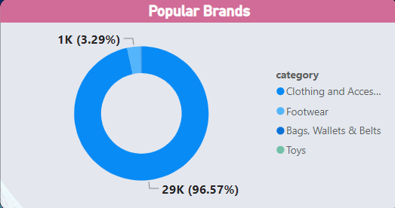
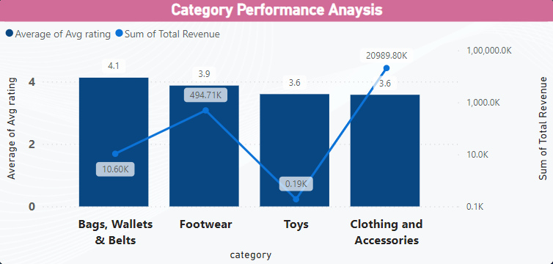
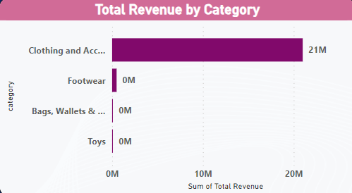
Insights into Popular Product Category
Clothing and Accessories is major categories (~97%) out of 4 categories.
Clothing has higher revenue as it has more number of Products.
Hence platform can increase their revenue by focus more other categories too.

Slide 9
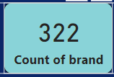
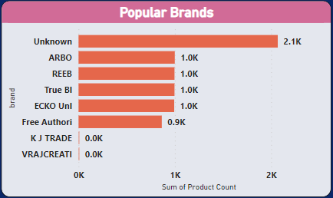
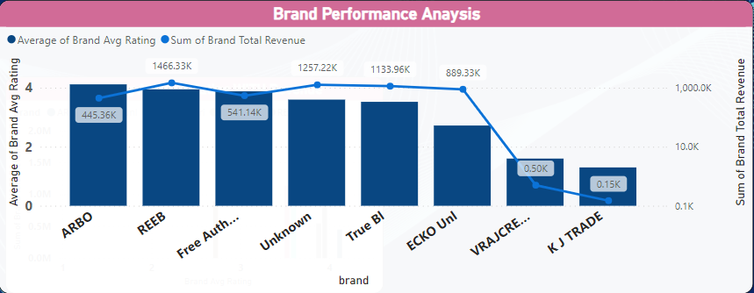
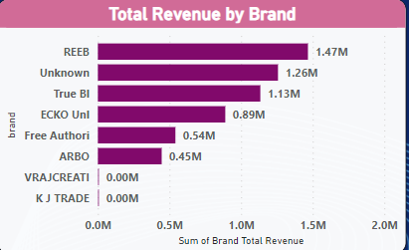
Insights into Popular Brands
Total 322 brands are available
2.1K products are unknown brands out of 28.08K products.
Pu, REEB, Unknown, True BI, ECKO Uni are revenue wise, Average rating wise and Product count wise top 5 brands
Revenue is getting increased, If average rating is more than 3.5 (There are few exceptional like ARBO, Free Auth)
We have many brands has lower rating and revenue like VRAJ CREATI, KJ TRADE.

Slide 10
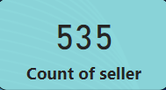
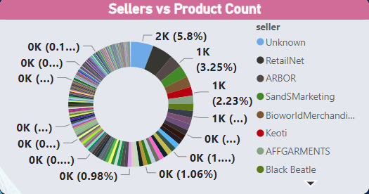
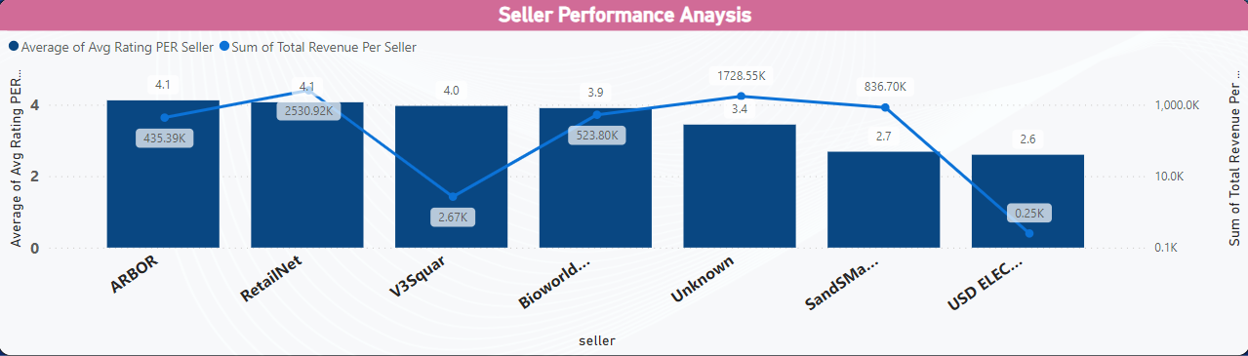
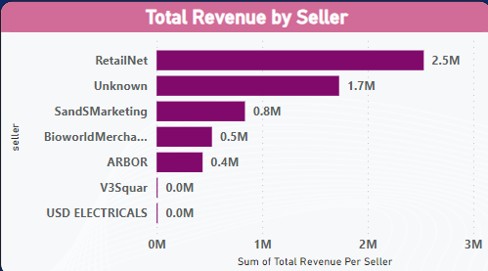
Understanding Seller Performance
Total 535 Sellers are available
2.1K products are sold by unknown sellers.
RetailNet, Unkown, SandsMarketing, Bioworld Mercha., are revenue wise, Average rating wise and Product count wise top 5 sellers
Revenue is getting increased, If more number of products under sellers and rating is more than 3.5 (There are few exceptional like V3 Squar, etc.,)
We have many brands has lower rating and revenue like USD ELECTRICALS, etc.,
Unknown seller has revenue of 1.7M

Slide 11
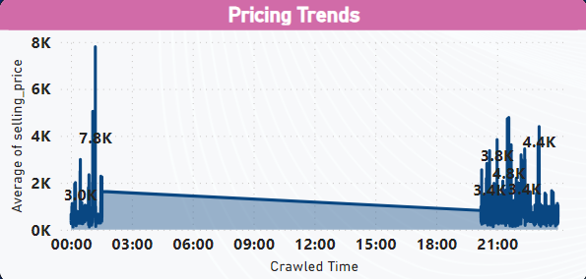
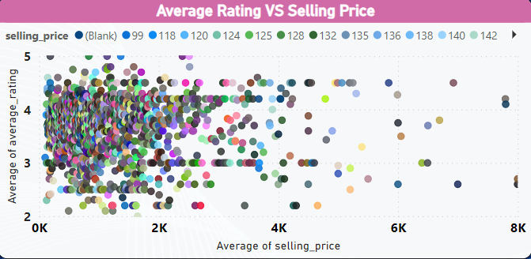
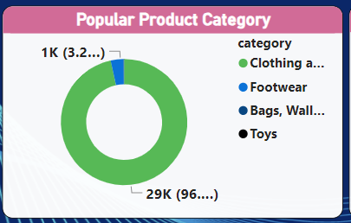
Analysing pricing trends and discount strategies
Night has higher prices and flunctuations than Day time.
Most of the products has rating around 3 to 4.4
Revenue is getting increased, If more number of products are available and having average rating above 3.5
Some of products are sold by unknown seller and unknown brand names. It needs to be addressed.
Few products are having very lower rating and very higher rating does not have significant amount of revenue.

Slide 12
Github URL : https://github.com/monishasathish07/PowerBI-Analysis-Projects Thanks you!!

